Slide 1

Pathology Image Analysis for Lung cancer prediction
Group: Codemasters (Edwin, Austin, Junaid, Abhishek)

Slide 2
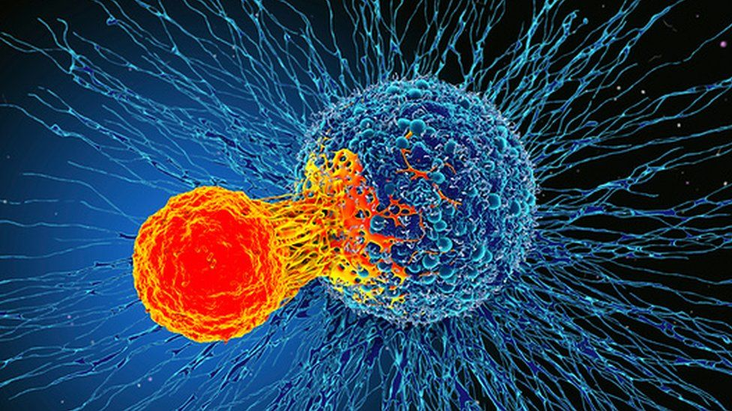
Overview of the Project
Main objective is to find the tumor present in the patients' lungs.

Slide 3
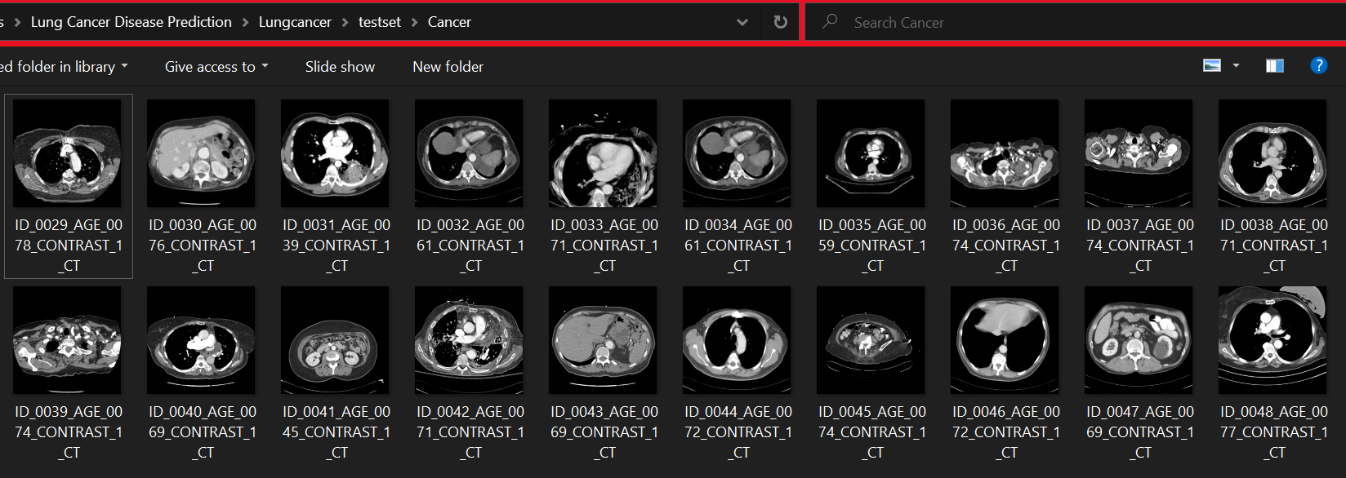
Data collection

Slide 4
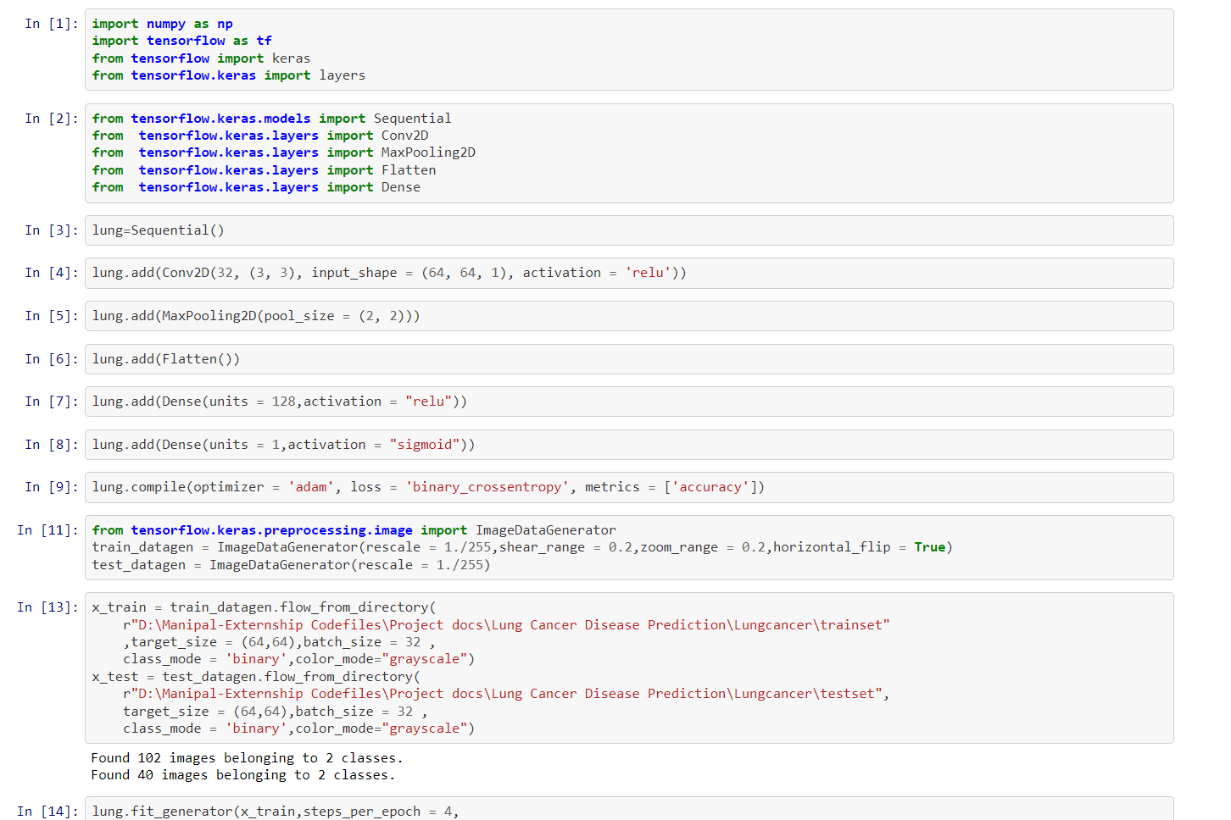
Model building

Slide 5
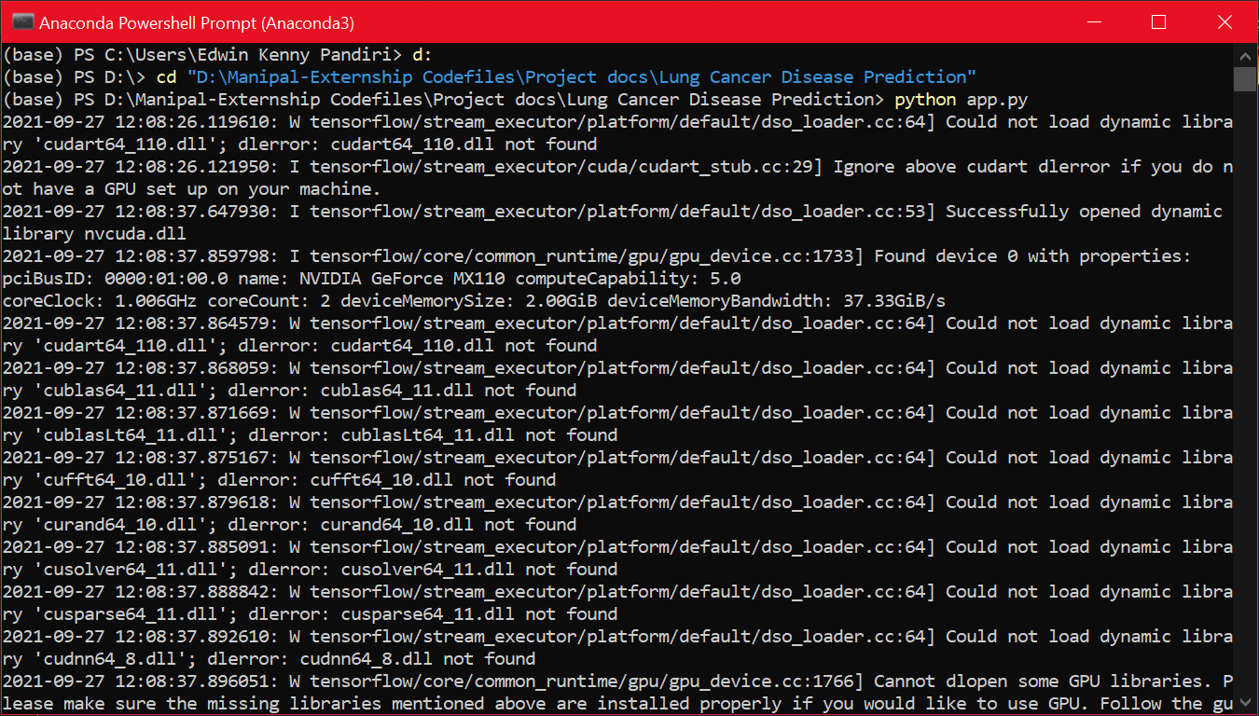
Working of the app

Slide 6
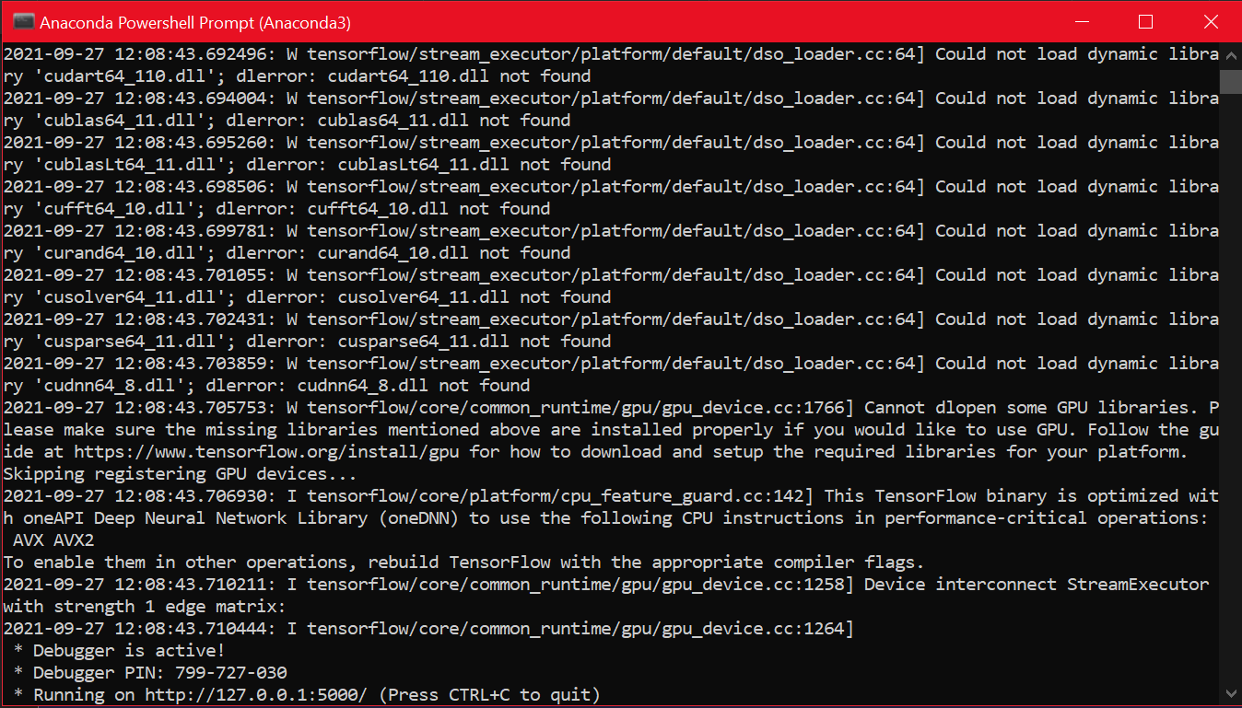

Slide 7


Slide 8
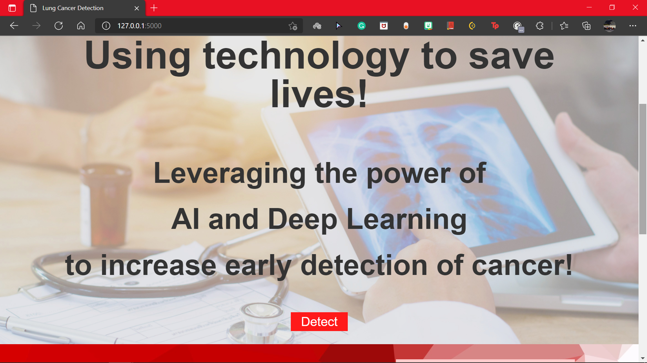

Slide 9
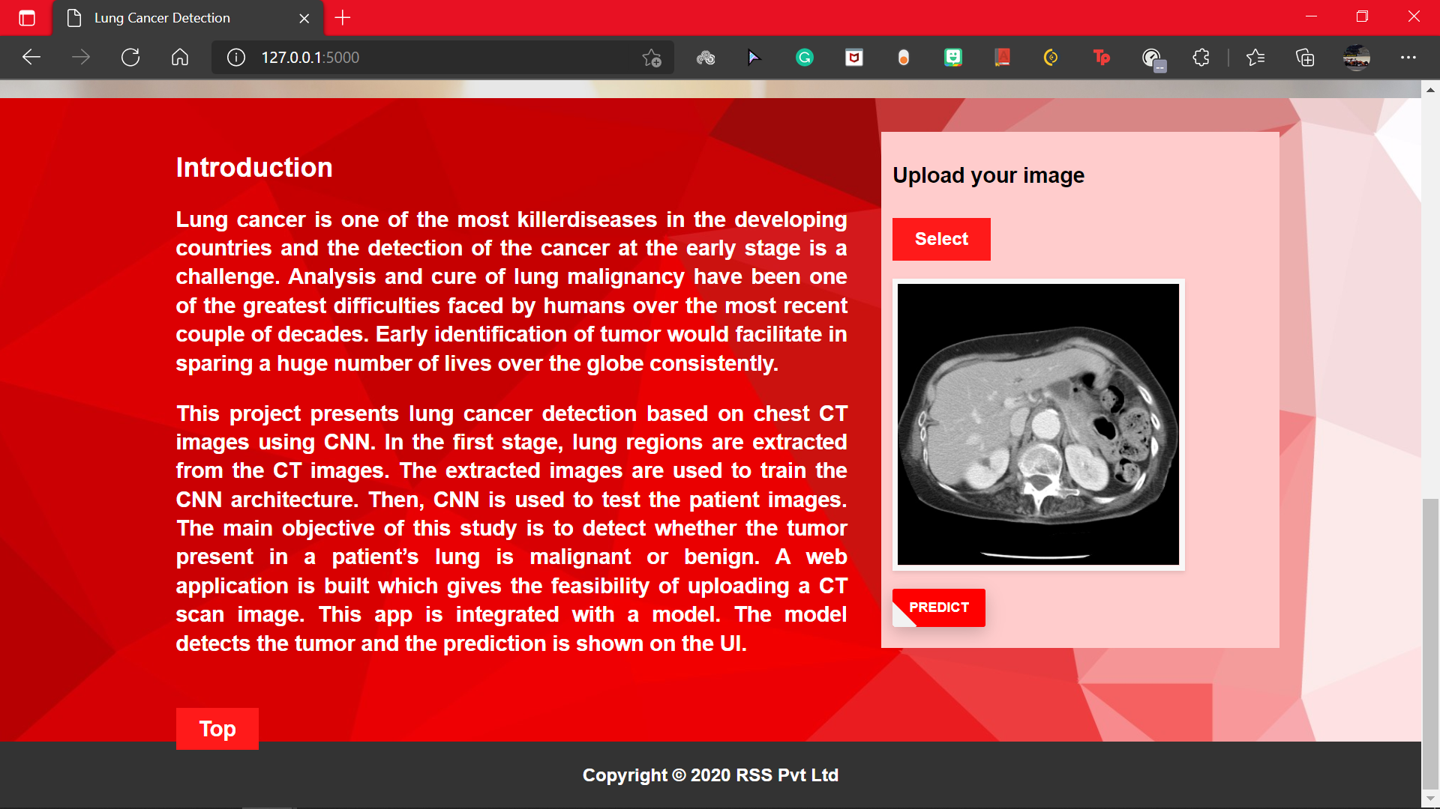

Slide 10
Thank you

